Slide 1


Crossroads Classic Analytics Challenge Phishing It Out
Taking Phishing Emails to the Cleaners
Notes:
Akshay

Slide 2
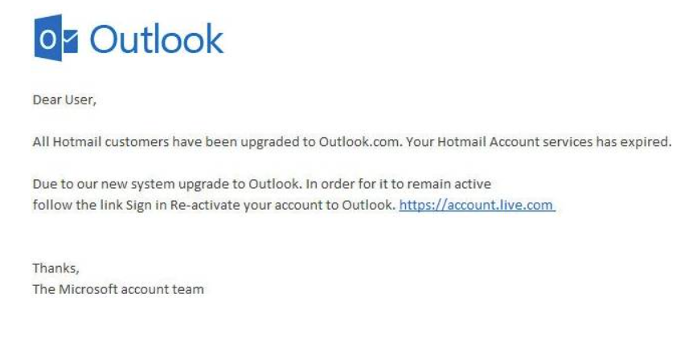
WHAT IS PHISHING
1 in 4200
33%
97%
Emails are phishing mails
Of spear phishing attacks target a single individual
Sophisticated phishing attacks were not identified by users (2015)

Slide 3
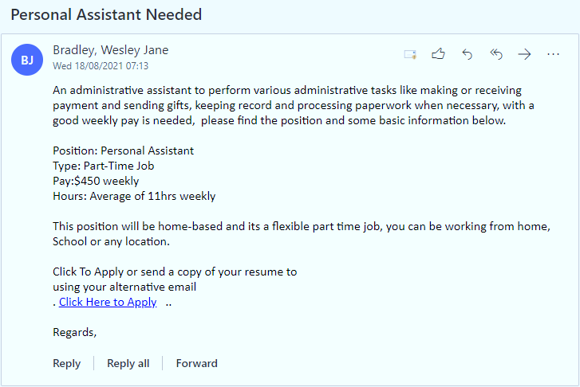
A TYPICAL PHISHING EMAIL
Monetary Job
Low effort High pay
Generic/No
Greeting
Grammatical
Error
Multiple spaces
Hourly/Weekly pay
Formatting
Click bait
Template Usage
Generic ending
Notes:
Achintya

Slide 4

WHAT’S OUR SOLUTION
Accuracy
One-stop-shop
for phishing detection solutions
Our flagship product
97%
Finalist
Notes:
Amit & Akshay - DONE

Slide 5



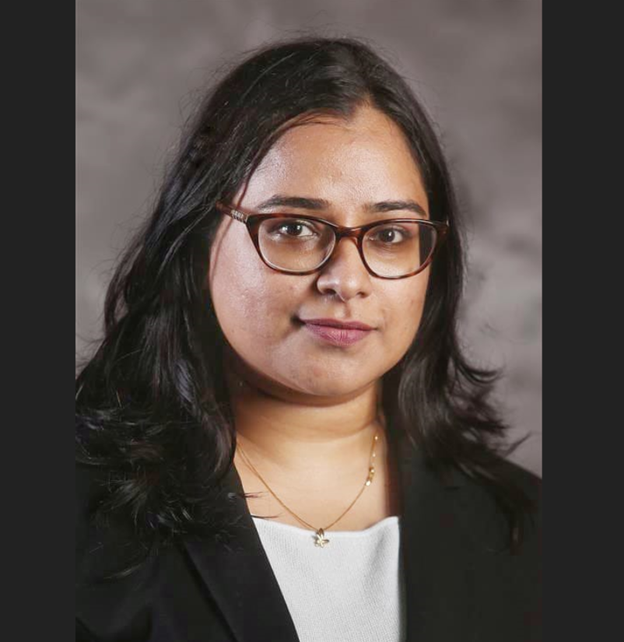

WHO WE ARE
Zainab Aljaroudi
Amit
Zutshi
Achintya
Acharya
Padma
Dwivedi
Akshay
Jayan
Team Lead
Specializes in analytical solutions and product development
NLP Expert
Specializes in analyzing unstructured data
NLP Expert
Specializes in optimization and API development
ML Consultant
Specializes in advanced analytics and design implementation
ML Design Expert
Specializes in product design, optimization and web scraping
Notes:
Padma: Done

Slide 6
HOW WE DID IT
Notes:
Zainab

Slide 7
METHODOLOGY
Public Training Data
CCAC Kaggle Data
12,000
4,898
Standard Meeting Emails
TRAIN
TEST
Exclamation Mark \ URL Counts
Awards \
Immediate Action
Similarity Check (Fuzzy Match)
EDA driven keyword enrichment
Notes:
Phishing terms :
Payment terms - "$50/hr","$45/hr","$40/hr","$35/hr","$30/hr","$25/hr","$20/hr","$400 weekly","$350 per week","$350 weekly","$300 weekly","$250 weekly“
Assistant terms - "personal assistant", "administrative assistant“
Ad terms - "walmart","reward“
Account issue terms - "Dear Employee And Staff", "verify your account","received a new message","@ccac sales","versions of our mailbox","moonfruit.com“
Subject terms – “APPLY NOW!!!”
Non-phishing terms :
Meeting terms - "microsoft teams meeting","zoom.us","webex.com", "teams.microsoft.com", "join zoom meeting","do not delete or change", "gartner.com“
Meeting subject terms - "accepted","canceled","declined","tentative","reminder","confirmation","1 on 1","hold“
Similarity checks –
Mail URLs and Sender Email Domain similarity
Sender Name and Sender Email similarity

Slide 8
MODEL IMPLEMENTATION
Random
Forest
Random
Forest
Random
Forest
LSTM & NN
LSTM & NN
LSTM & NN
Naïve
Bayes
83%
86%
97%
60%
88%
SVM
SVM
SVM
SVM
SVM
XGBoost
XGBoost
XGBoost
XGBoost
XGBoost

Slide 9
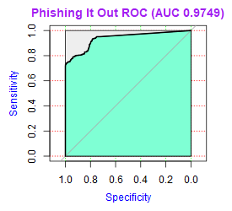
PERFORMANCE
Selected Model

Slide 10
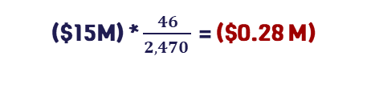
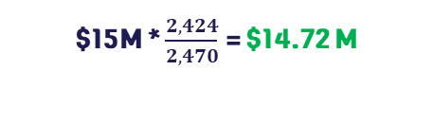
WHAT’S THE VALUE ADD?
 |  |  | Actuals
 |  |  | Non-Phishing | Phishing
Predicted | Non-Phishing |  | 9,305 | 46
 | Phishing |  | 225 | 2,424
($15M) * $\frac{46}{2,470 }$ = ($0.28 M)
$15M * $\frac{2,424}{2,470}$ = $14.72 M
$14,441,000
Notes:
Zainab

Slide 11
WHAT WE LEARNED
Notes:
Amit

Slide 12
PROFILES OF PHISHING EMAILS
Account issues
- Exceeding memory usage
- Account renewal/expiry
Easy money/jobs
- Personal assistant
- $ Per week earnings
Promise of rewards
- Store rewards
- Gift cards req. info.
Miscellaneous
- Giveaway items (Pianos)
- Free tickets
Verify your account NOW
REWARDS!!!
$450/weekly
Free piano
Account disabled
You have won!!
Personal assistant needed immediately
Complimentary upgrade

Slide 13
PRODUCT FEATURES
Coming Soon
Scalable
User Friendly
API Enabled
Adaptive Learning

Slide 14
RESULTS IN ACTION
Notes:
Achintya

